Slide 1
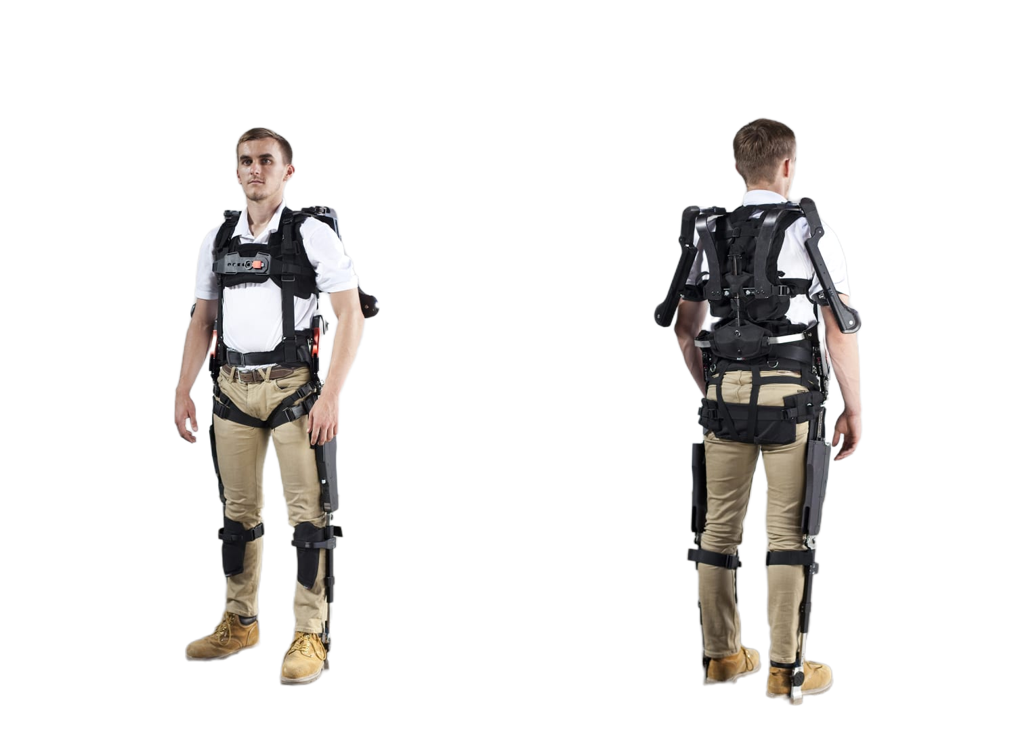
Task - 1
Robotic Exoskeleton for mobility assistance
Rutuj Nagarkar

Slide 2
Index
Overview
Understanding the problems
Working Principles
Current limitations
Future Improvements
Cycle diagram

Slide 3
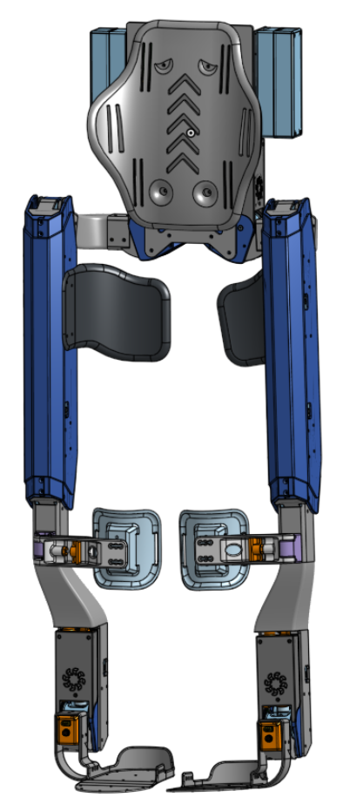

Overview
Robotic exoskeletons for mobility assistance are wearable devices that combine robotics, sensors, and computer systems to support human movement.
They are used for medical rehabilitation and as assistive devices for daily mobility, mainly for people with lower-limb disabilities.

Slide 4
Understanding the problems
01
Global issue: Millions suffer from paralysis, spinal cord injuries, muscle weakness, or immobility due to aging.
02
Wheelchairs assist with mobility, but they do not offer natural walking or muscle rehabilitation.
03
Current exoskeletons, are too expensive, costing over $50,000, and are not widely available.
Need
An affordable, lightweight, and user-friendly robotic exoskeleton for daily life assistance.

Slide 5
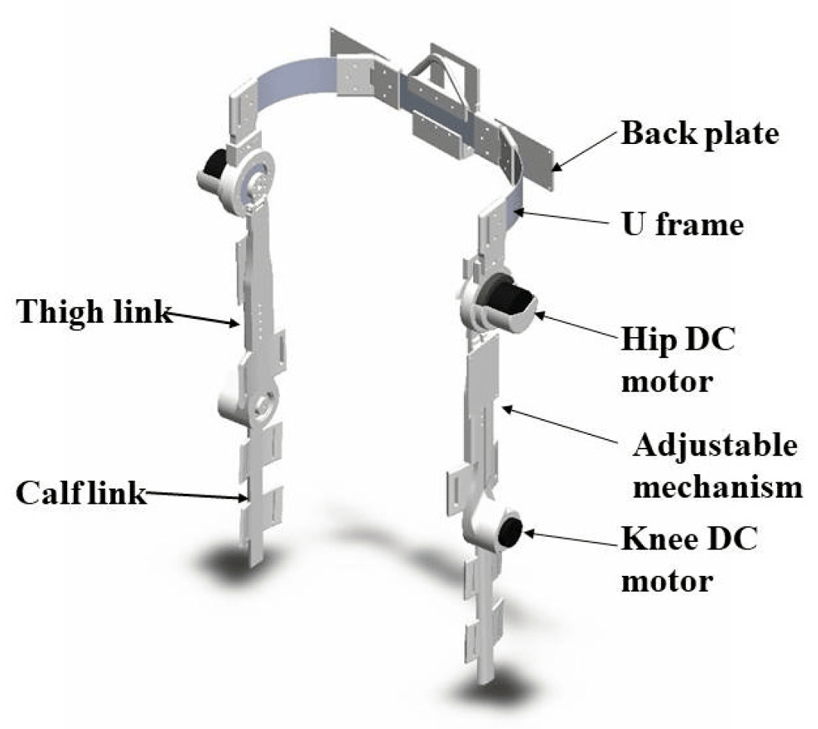
Working Principles
Robotic exoskeletons work by combining a mechanical structure, sensors, a control unit, and actuators to help or enhance human movement. They act like wearable robots that move along with the user.
Exoskeletons have a frame with joints that align with the wearer's hips, knees, and ankles. This structure can be rigid or semi-soft, providing the physical foundation for the device.
Sensors such as pressure sensors on the feet or inertial measurement units (IMUs) detect the user's intent to move, maintain balance, and determine body position. Some systems also use electromyography (EMG) sensors to read muscle activity. This information acts as input for the system.

Slide 6
Working Principles
A control unit, usually a microcontroller or computer system, processes the sensor data. It calculates the necessary torque and timing for the actuators to support the user's intended movement, ensuring smooth and coordinated motion.
Actuators, powered by a lithium-ion battery, include motors (servo, DC), hydraulics, or pneumatics that apply force to the joints. They give powered support to assist the user's leg movement and help bear weight. These power systems can run the actuators for 4 to 6 hours.
Users can start actions, such as standing or walking, using various control inputs, including joysticks, control pads, or natural weight-shifting motions. For safety, many exoskeletons include features like emergency stops and fall detection alarms.

Slide 7
Current Limitations
High Cost: Clinical-grade exoskeletons have a prohibitive price, though more affordable consumer models are becoming available.
User Challenges: Issues like lengthy fitting times, heavy or cumbersome designs, and compatibility problems for users with specific injuries or conditions (e.g., contractures or sensitive skin) can limit adoption.
Weight and Portability: Rigid models can be heavy, which impacts portability and speed, although soft robotic exosuits offer a lightweight alternative.
Safety and Comfort: Some users report discomfort from straps and harnesses, and there are concerns about potential pressure injuries or joint misalignment.

Slide 8
Future Improvements
AI and Machine Learning: Ongoing research is using AI and machine learning to create personalized, intuitive assistance for users.
Soft Robotics: The field of soft robotics is focusing on creating lighter, more comfortable, and more adaptive exoskeletons using flexible materials and advanced sensors.
Hybrid Systems: Researchers are exploring systems that combine robotics with functional electrical stimulation (FES) to generate muscle contractions.
Home and Outdoor Use: Future designs aim to be lighter, faster, and more robust to handle uneven terrains, making them practical for home and community use.

Slide 9
THANK YOU

